Slide 1
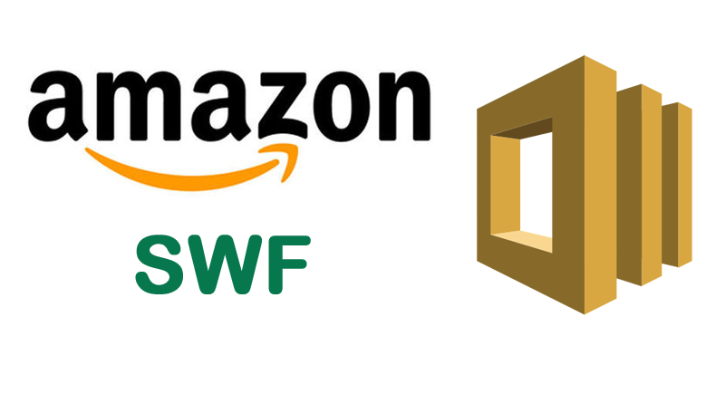

Slide 2

Topics
What is Amazon SWF
SWF and SQS
SWF Actors
Exam Tip

Slide 3

What is Amazon SWF?
Simple workflow service is web service that makes it easy to coordinate work across distributed application components.
It's a way of coordinating work across a whole bunch of different components within your application
SWF enables applications for a range of use cases including media processing, web application back-ends, business process workflows and analytic pipelines to be designed as a coordination of tasks
Tasks represents invocation of various processing steps in an application which can be performed by executable code, web service calls, human interactions/action and scripts.

Slide 4
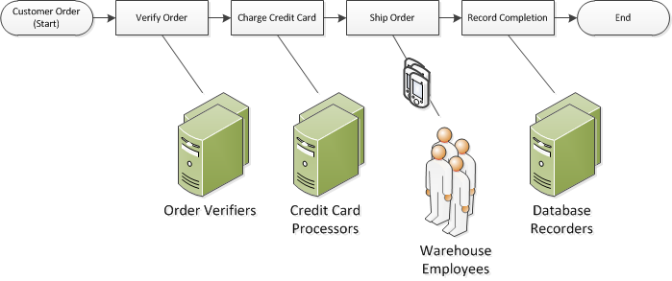
What is Amazon SWF?

Slide 5
SWF and SQS
SQS has a retention period of 14 days and with SWF the workflow executions can last up to 1 year.
Amazon SWF presents a task orientated API whereas Amazon SQS offers a message orientated API
SWF ensures that a task is assigned only once and is never duplicated. With SQS you need to handle duplicated messages and may also need to ensure that a message is processed only once
SWF keeps track of all the tasks and events in an application. With SQS, you need to implement your own application-level tracking, especially if your applications use multiple queues.

Slide 6
SWF Actors
Workflow Starters : An application that can initiate or start a workflow. Could be your e-commerce website following the placement of an order of mobile app searching for bus times
Deciders : Controls the flow of the activity tasks in a workflow execution. If something has finished or failed in a workflow, a decider decides what to do next
Activity Workers : Carry out the activity tasks

Slide 7
Thank you

